Slide 1

Digital Image Processing
Unit-3: Image Enhancement in Frequency Domain
Dr. Piyush Joshi
Indian Institute of Information Technology
Sri City, Andhra Pradesh

Slide 2
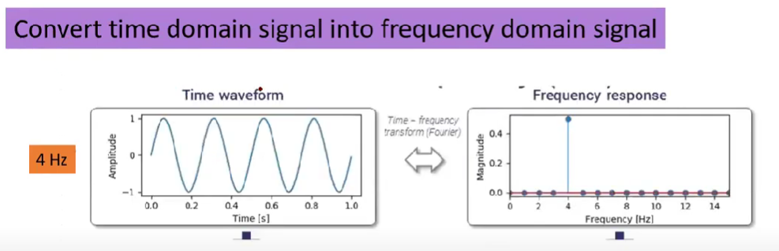
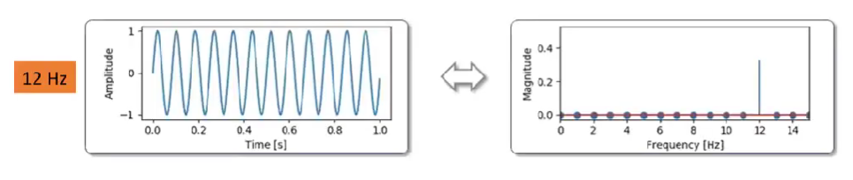
Image Enhancement in Frequency Domain

Slide 3
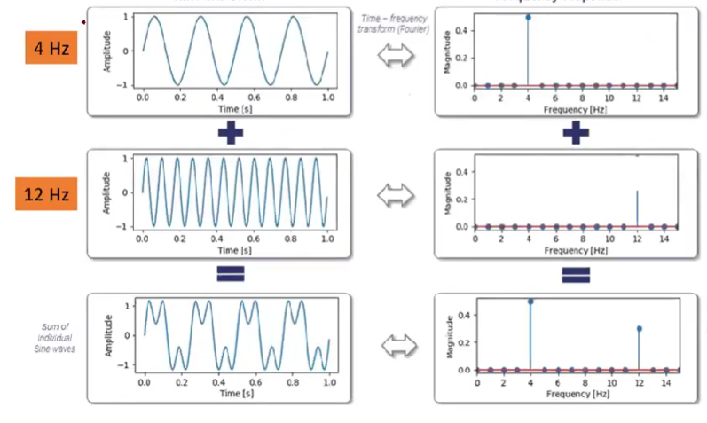
Image Enhancement in Frequency Domain

Slide 4
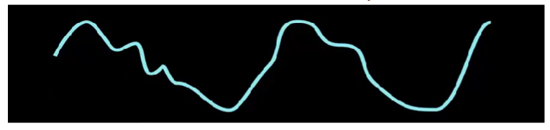
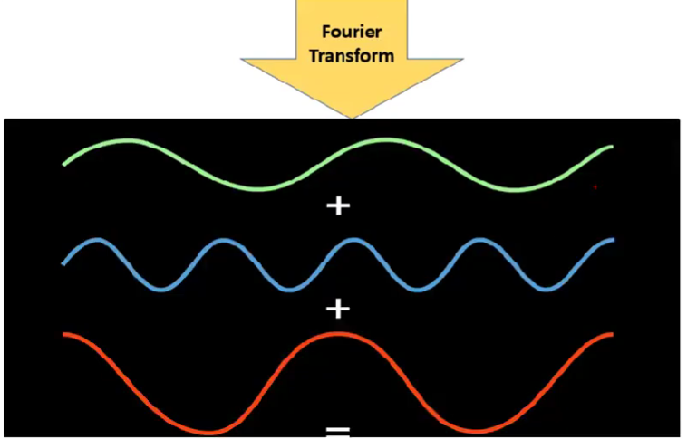

Slide 5

Image Enhancement in Frequency Domain
Introduction
Fourier Series
Any periodic function can be expressed as the sum of
sines and /or cosines of different frequencies, each
multiplied by a different coefficients.
Fourier Transform
Any function that is not periodic can be expressed as the
integral of sines and /or cosines multiplied by a weighing
function.
Jean Baptiste Joseph Fourier, French mathematician and physicist (03/21/1768-05/16/1830)

Slide 6
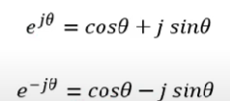
Image Enhancement in Frequency Domain
Fourier Series

Slide 7
Image Enhancement in Frequency Domain
1-D Fourier Transform: Continuous Variable

Slide 8
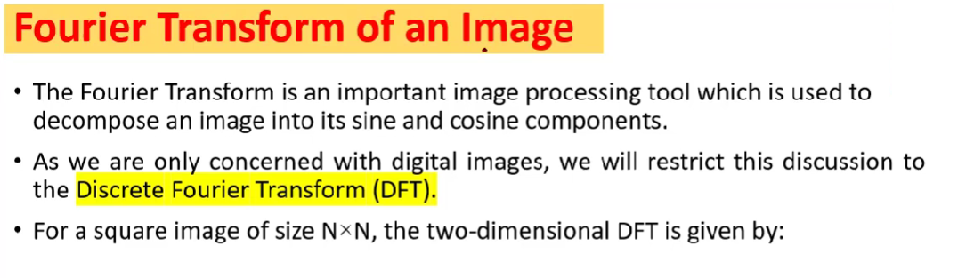
Image Enhancement in Frequency Domain

Slide 9
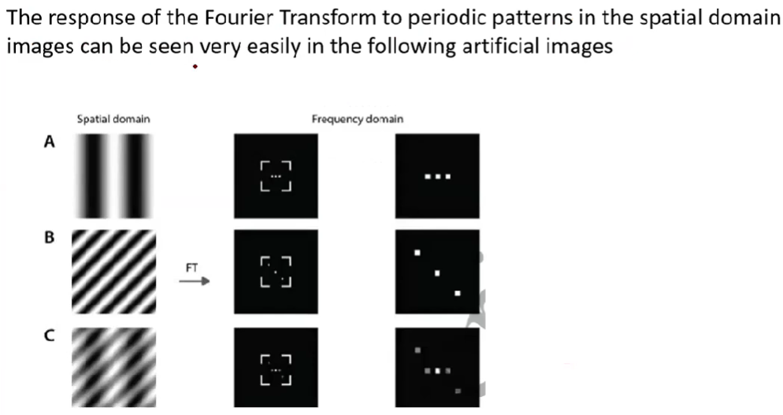
Fourier Transform of an image

Slide 10
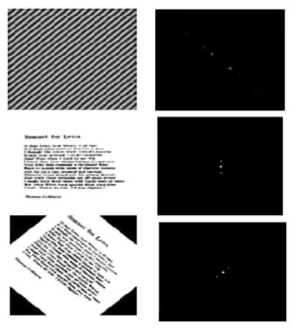
Fourier Transform of an image

Slide 11
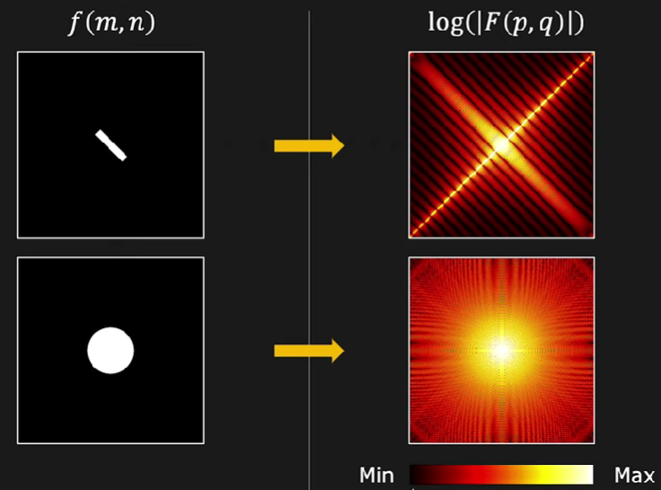

Slide 12
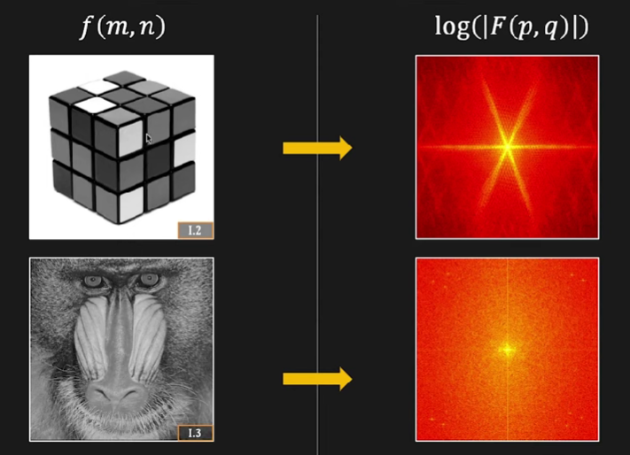

Slide 13
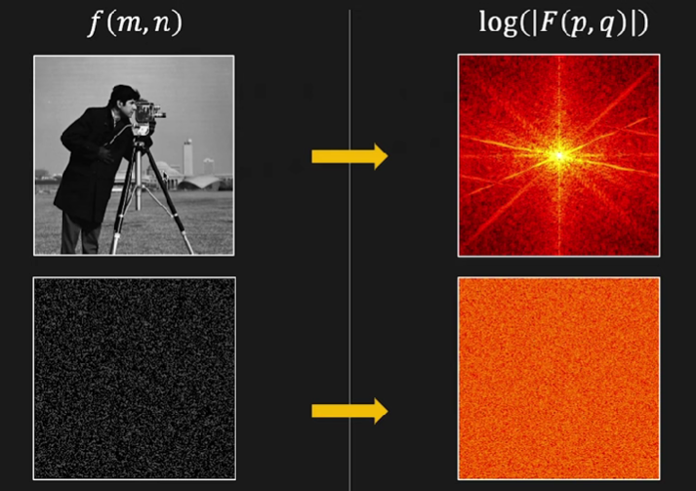

Slide 14
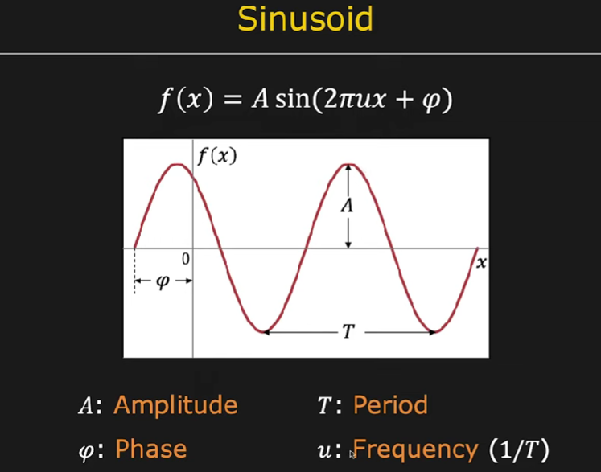

Slide 15
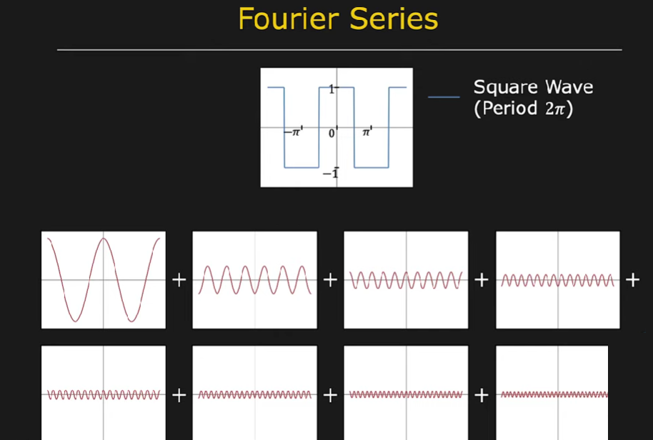

Slide 16
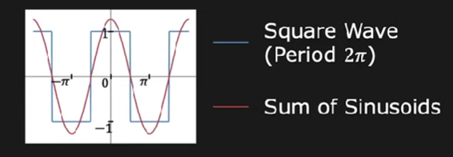
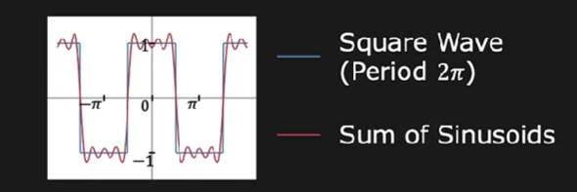
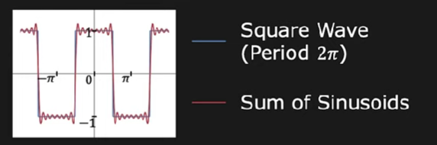
One sinusoids
Sum of first four sinusoids
Sum of eight sinusoids

Slide 17
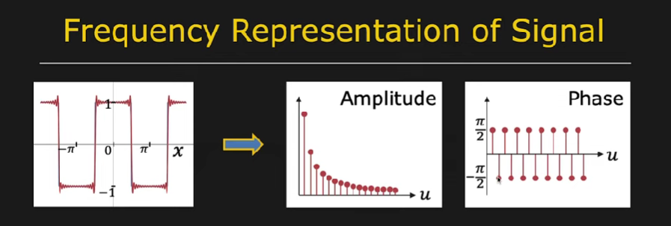

Slide 18
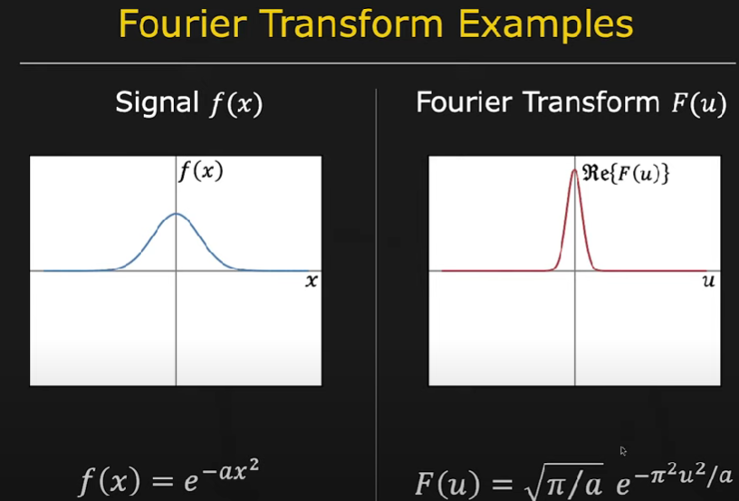

Slide 19
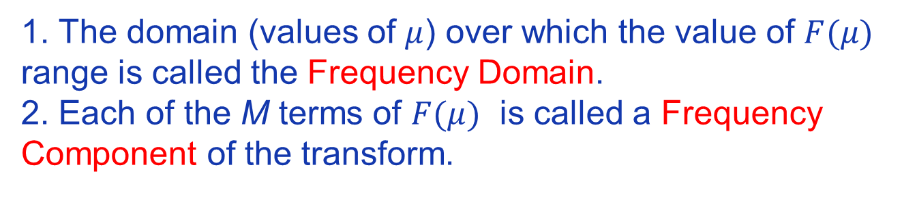
Image Enhancement in Frequency Domain
1-D Discrete Fourier Transform
1. The domain (values of $μ$) over which the value of $F(μ)$
range is called the Frequency Domain.
2. Each of the M terms of $F(μ)$ is called a Frequency
Component of the transform.

Slide 20
Image Enhancement in Frequency Domain
2-D Fourier Transform: Continuous Variable

Slide 21
Image Enhancement in Frequency Domain
2-D Discrete Fourier Transform and Its Inverse

Slide 22
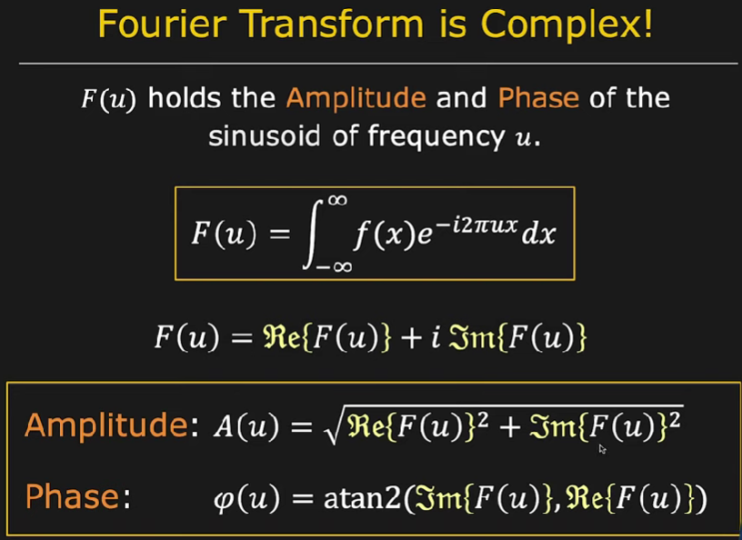

Slide 23
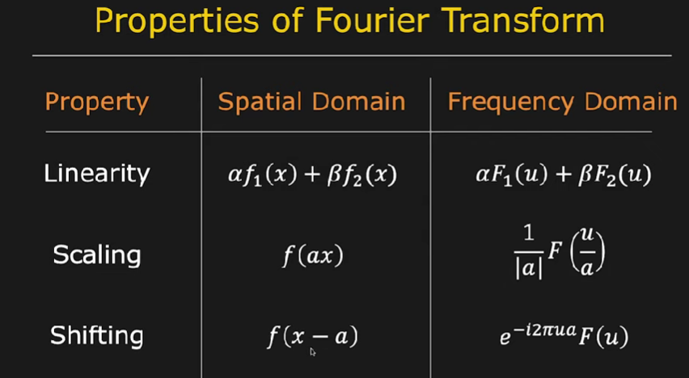

Slide 24
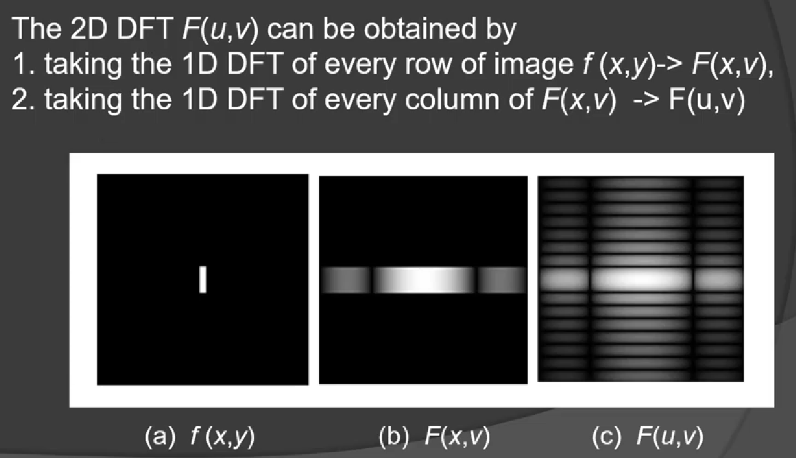
Properties of 2-D DFT: Separability

Slide 25
Image Enhancement in Frequency Domain
Properties of 2-D DFT: Shift

Slide 28
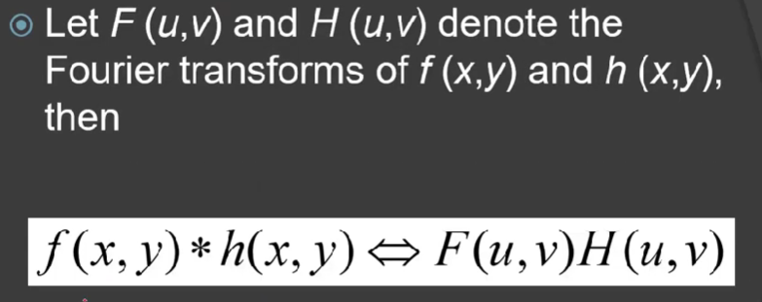
Image Enhancement in Frequency Domain
Properties of 2-D DFT: Convolution

Slide 29
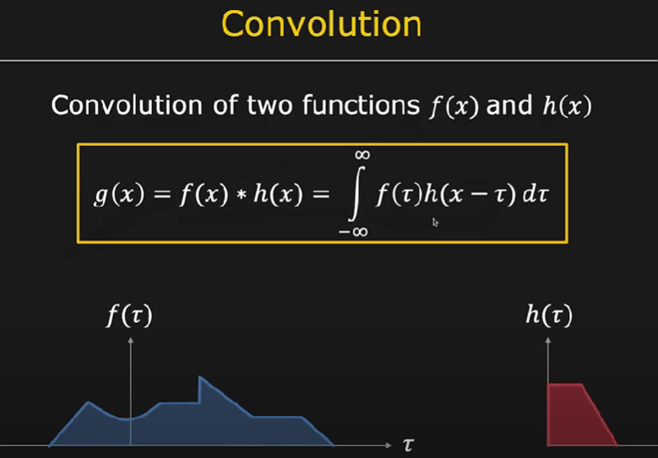

Slide 31
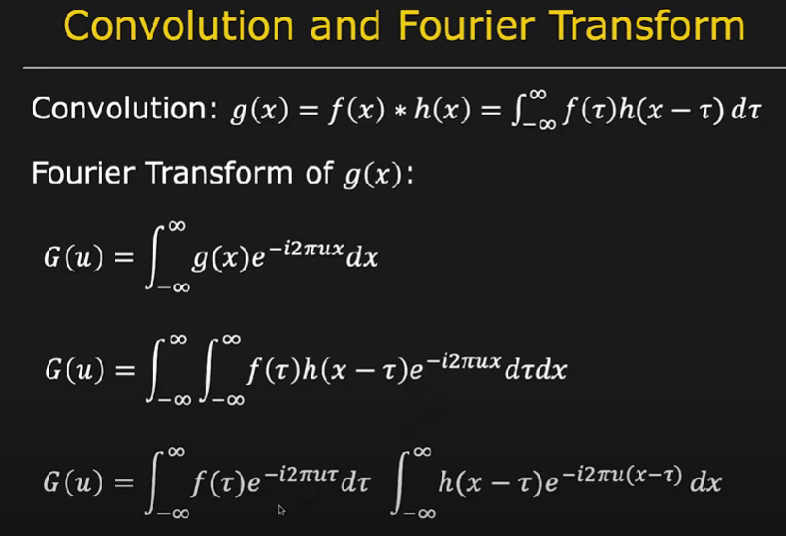

Slide 32
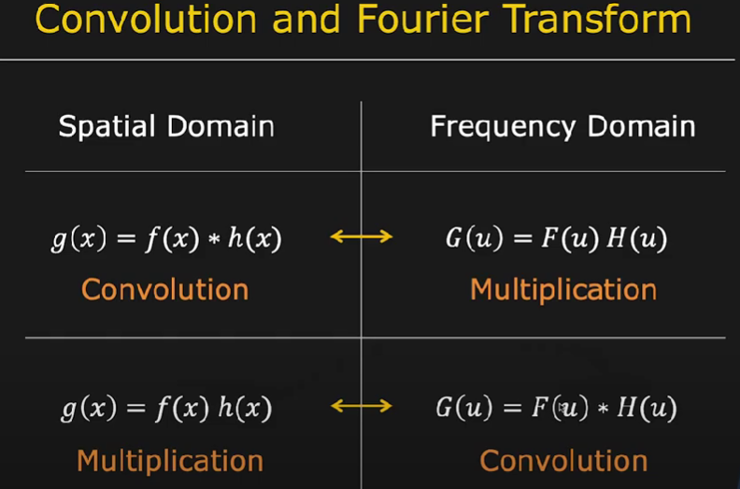

Slide 33
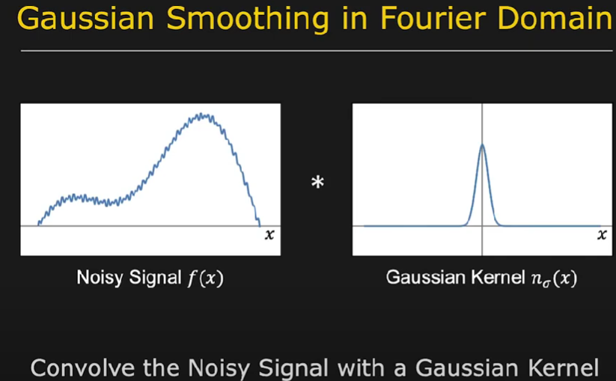

Slide 34
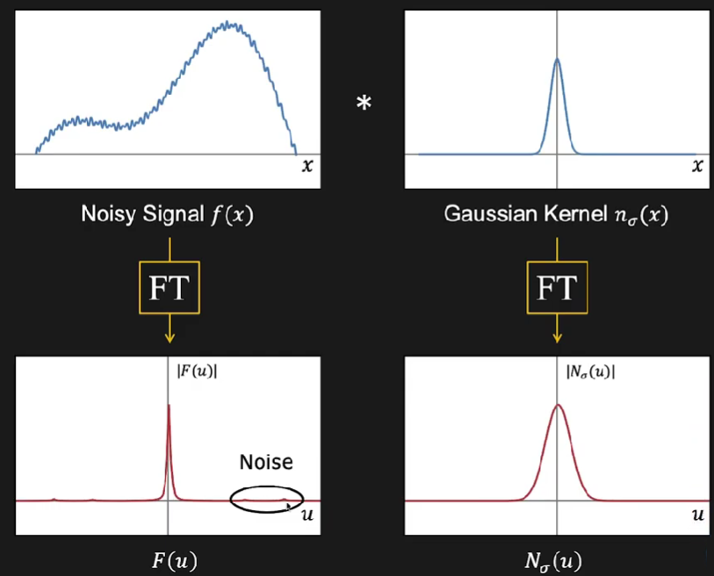

Slide 35
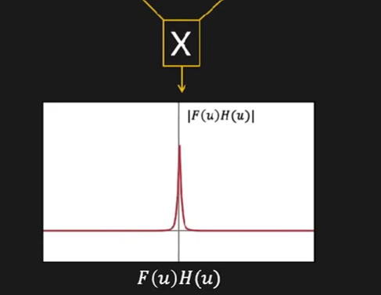
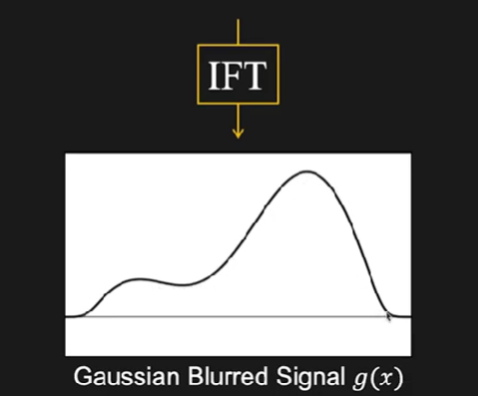

Slide 37
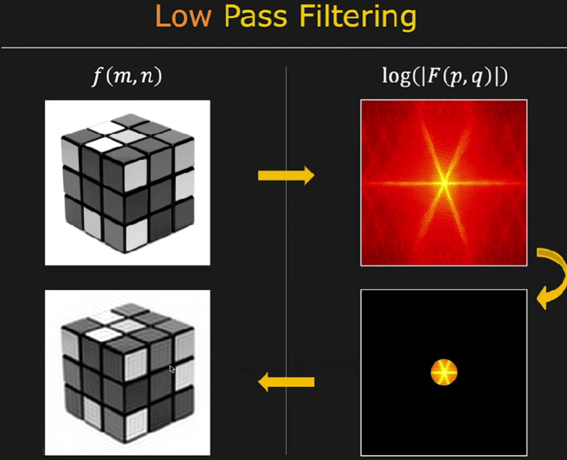

Slide 38
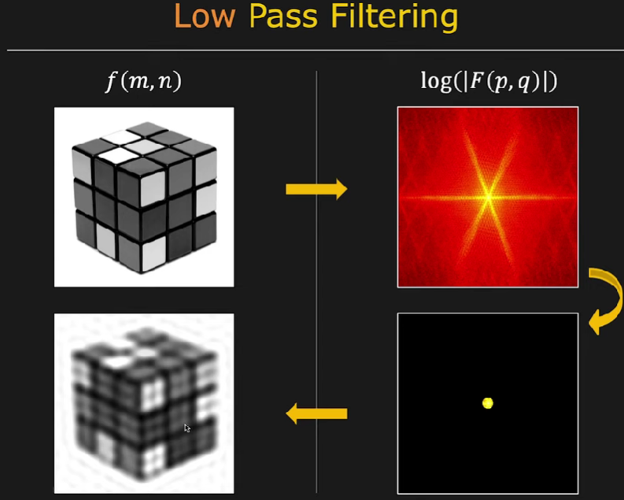
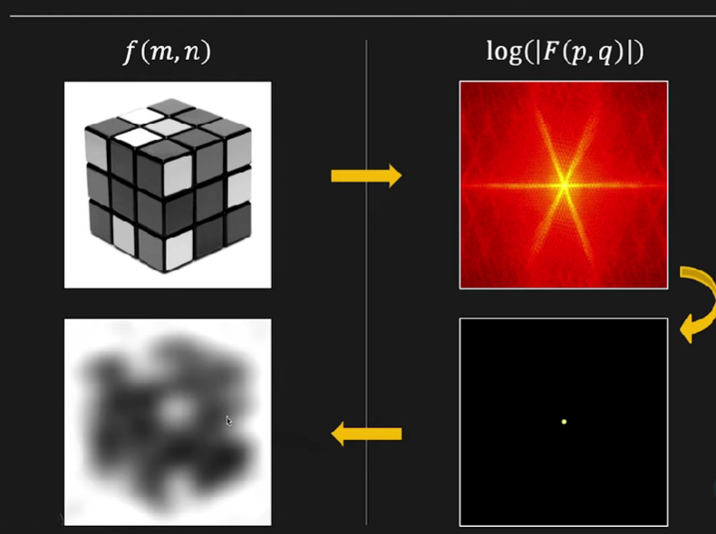

Slide 39
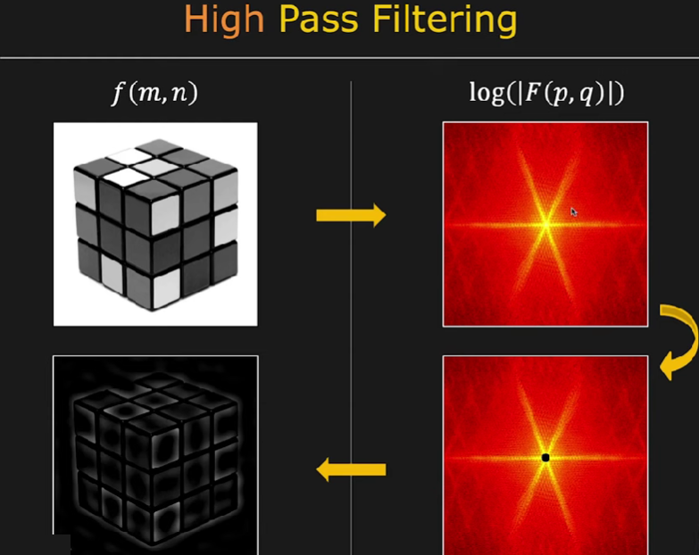

Slide 40
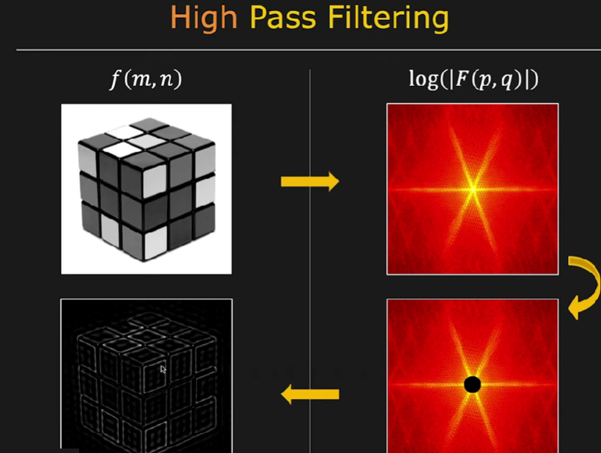
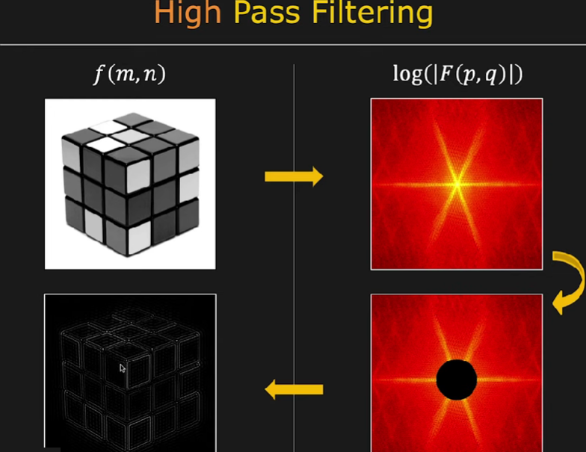

Slide 41
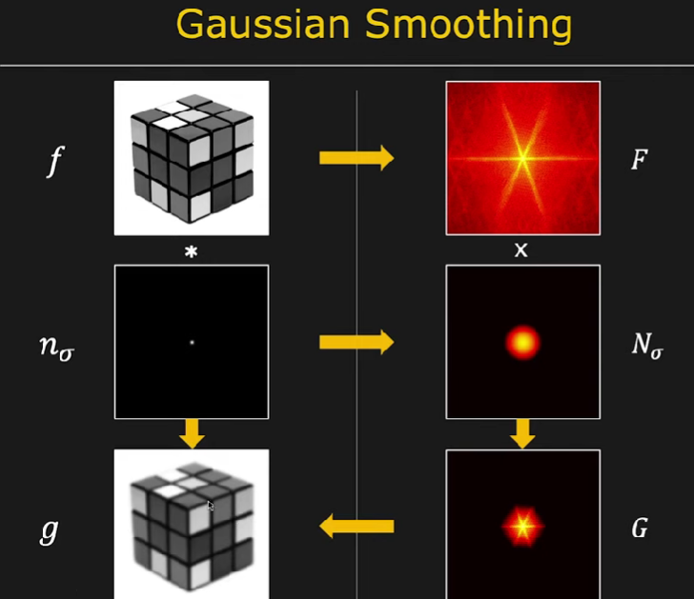

Slide 42
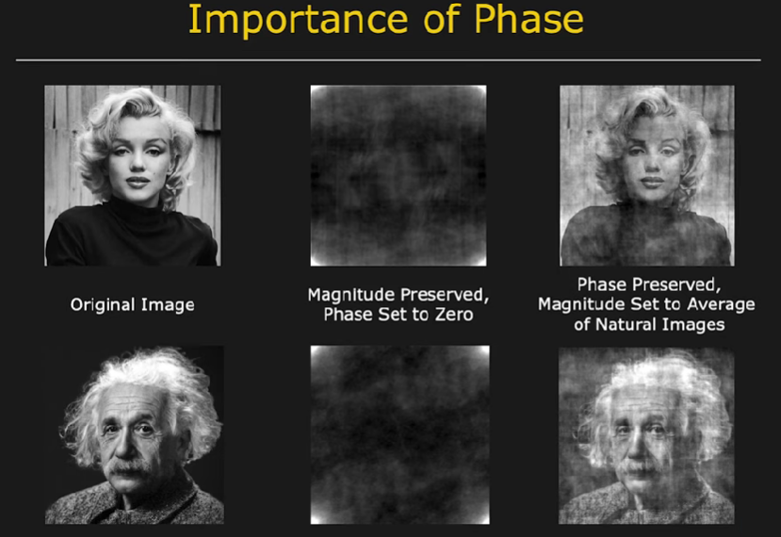

Slide 43
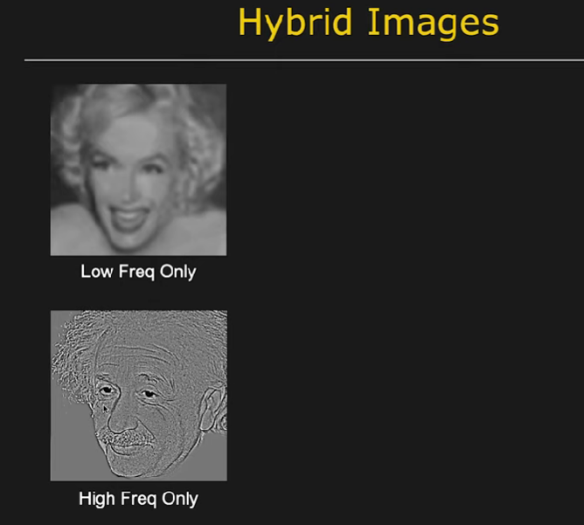

Slide 44
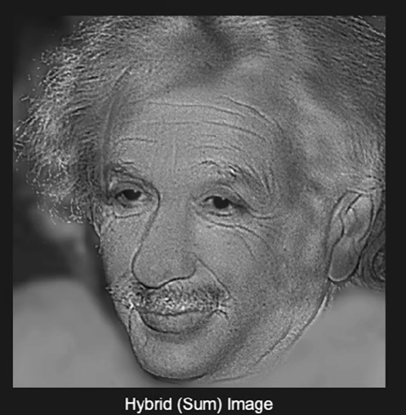

Slide 46
Image Enhancement in Frequency Domain
Filtering in Frequency Domain: Properties
Low frequencies in the Fourier transform are responsible
for the general gray-level appearance of an image over
smooth regions.
High frequencies are responsible for detail, such as edges and noise.
A filter that attenuates high frequencies while “passing” the low frequencies is called lowpass filter.
A filter that attenuates low frequencies while “passing” the high frequencies is called highpass filter.

Slide 47
Image Enhancement in Frequency Domain
Smoothing Filters
Edges and other sharp transitions (such as noise) contribute significantly to the high frequency content of Fourier transform.
Smoothing (blurring) is achieved in frequency domain by attenuating a specified range of high frequency components.
Three types of lowpass filters: Ideal, Butterworth and Gaussian filters
These filters cover the range from very sharp (ideal) to very smooth (Gaussian) filter functions.

Slide 48
Image Enhancement in Frequency Domain
Smoothing Filters: Ideal Lowpass Filters (ILPF)

Slide 49
Image Enhancement in Frequency Domain
Smoothing Filters: ILPF

Slide 50
Image Enhancement in Frequency Domain
Smoothing Filters: ILPF

Slide 52
Image Enhancement in Frequency Domain
Smoothing Filters: Butterworth Lowpass Filters (BLPF)

Slide 53
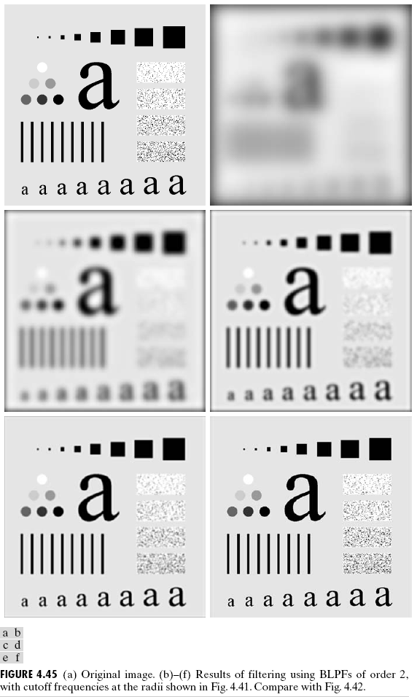

Slide 54
Image Enhancement in Frequency Domain
Smoothing Filters: Gaussian Lowpass Filters (GLPF)

Slide 55
Image Enhancement in Frequency Domain
Smoothing Filters: GLPF

Slide 57
Image Enhancement in Frequency Domain
Smoothing Filters: Example of smoothing by GLPF

Slide 58
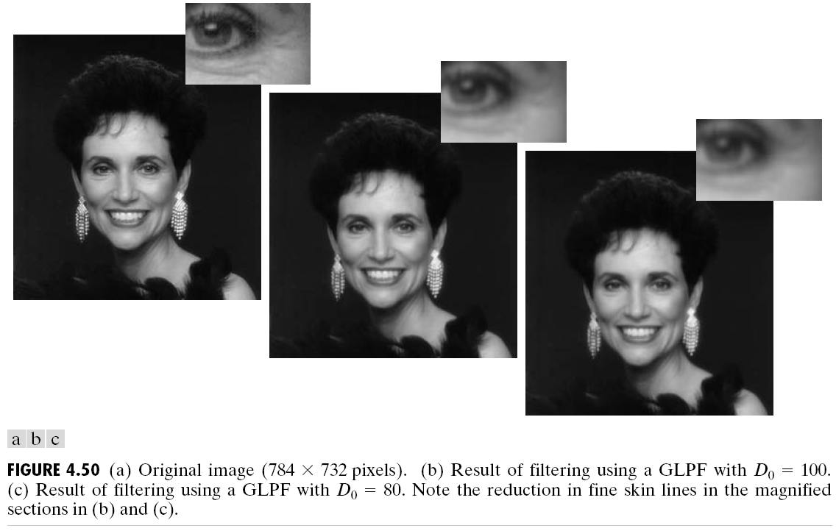
Image Enhancement in Frequency Domain
Smoothing Filters: Example of smoothing by GLPF

Slide 59
Image Enhancement in Frequency Domain
Smoothing Filters: Example of smoothing by GLPF

Slide 60
Image Enhancement in Frequency Domain
Sharpening Filters
Image sharpening can be achieved in the frequency domain by highpass filtering.
It attenuates low-frequency components without disturbing high-frequency information in the Fourier transform.

Slide 61
Image Enhancement in Frequency Domain
Sharpening Filters
A highpass filter is obtained from a given lowpass filter using

Slide 62
Image Enhancement in Frequency Domain
Sharpening Filters

Slide 63
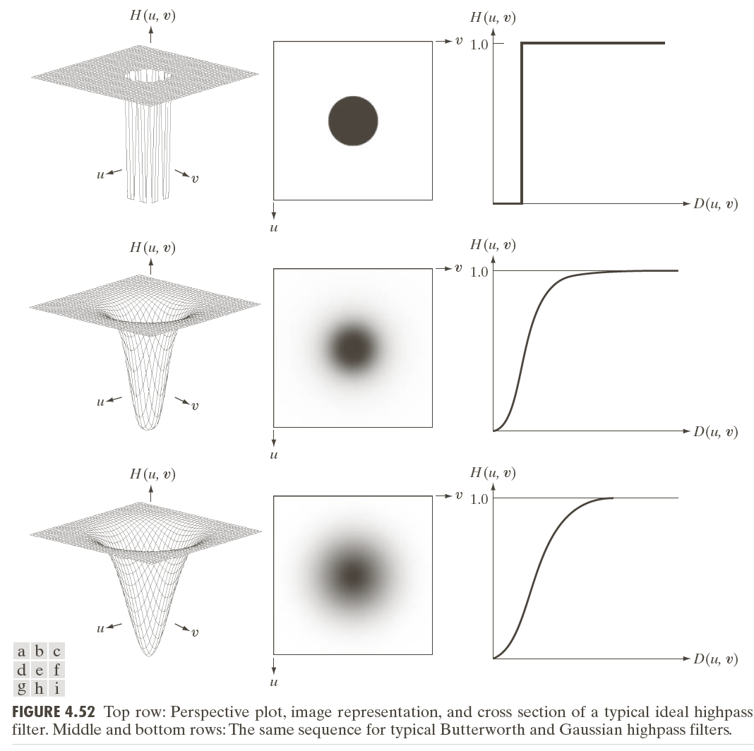

Slide 64
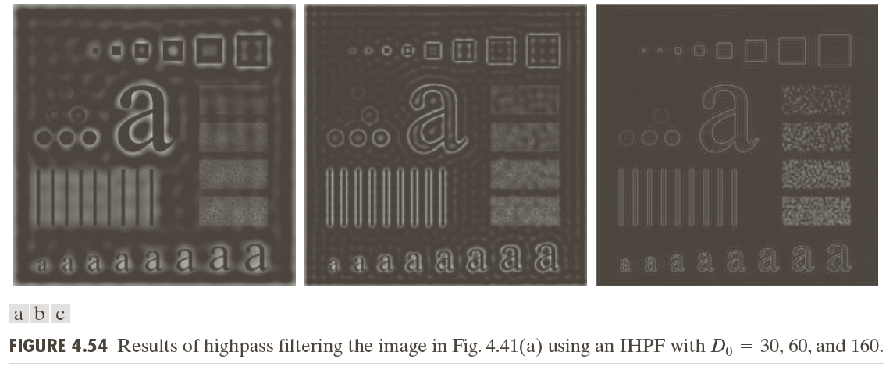
Image Enhancement in Frequency Domain
Sharpening Filters: Result of IHPF

Slide 65
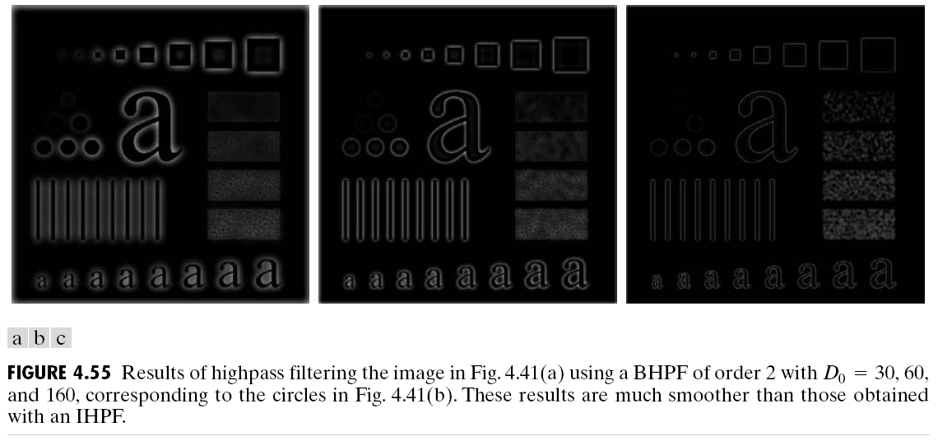
Image Enhancement in Frequency Domain
Sharpening Filters: Result of BHPF

Slide 66
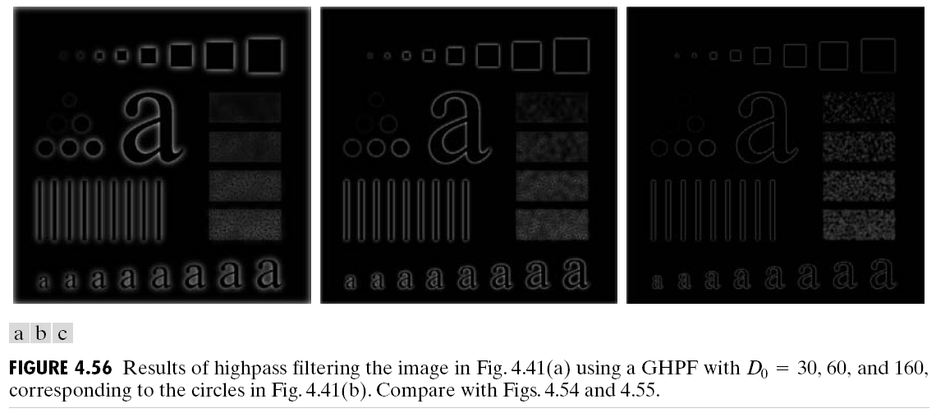
Image Enhancement in Frequency Domain
Sharpening Filters: Result of GHPF

